Slide 1
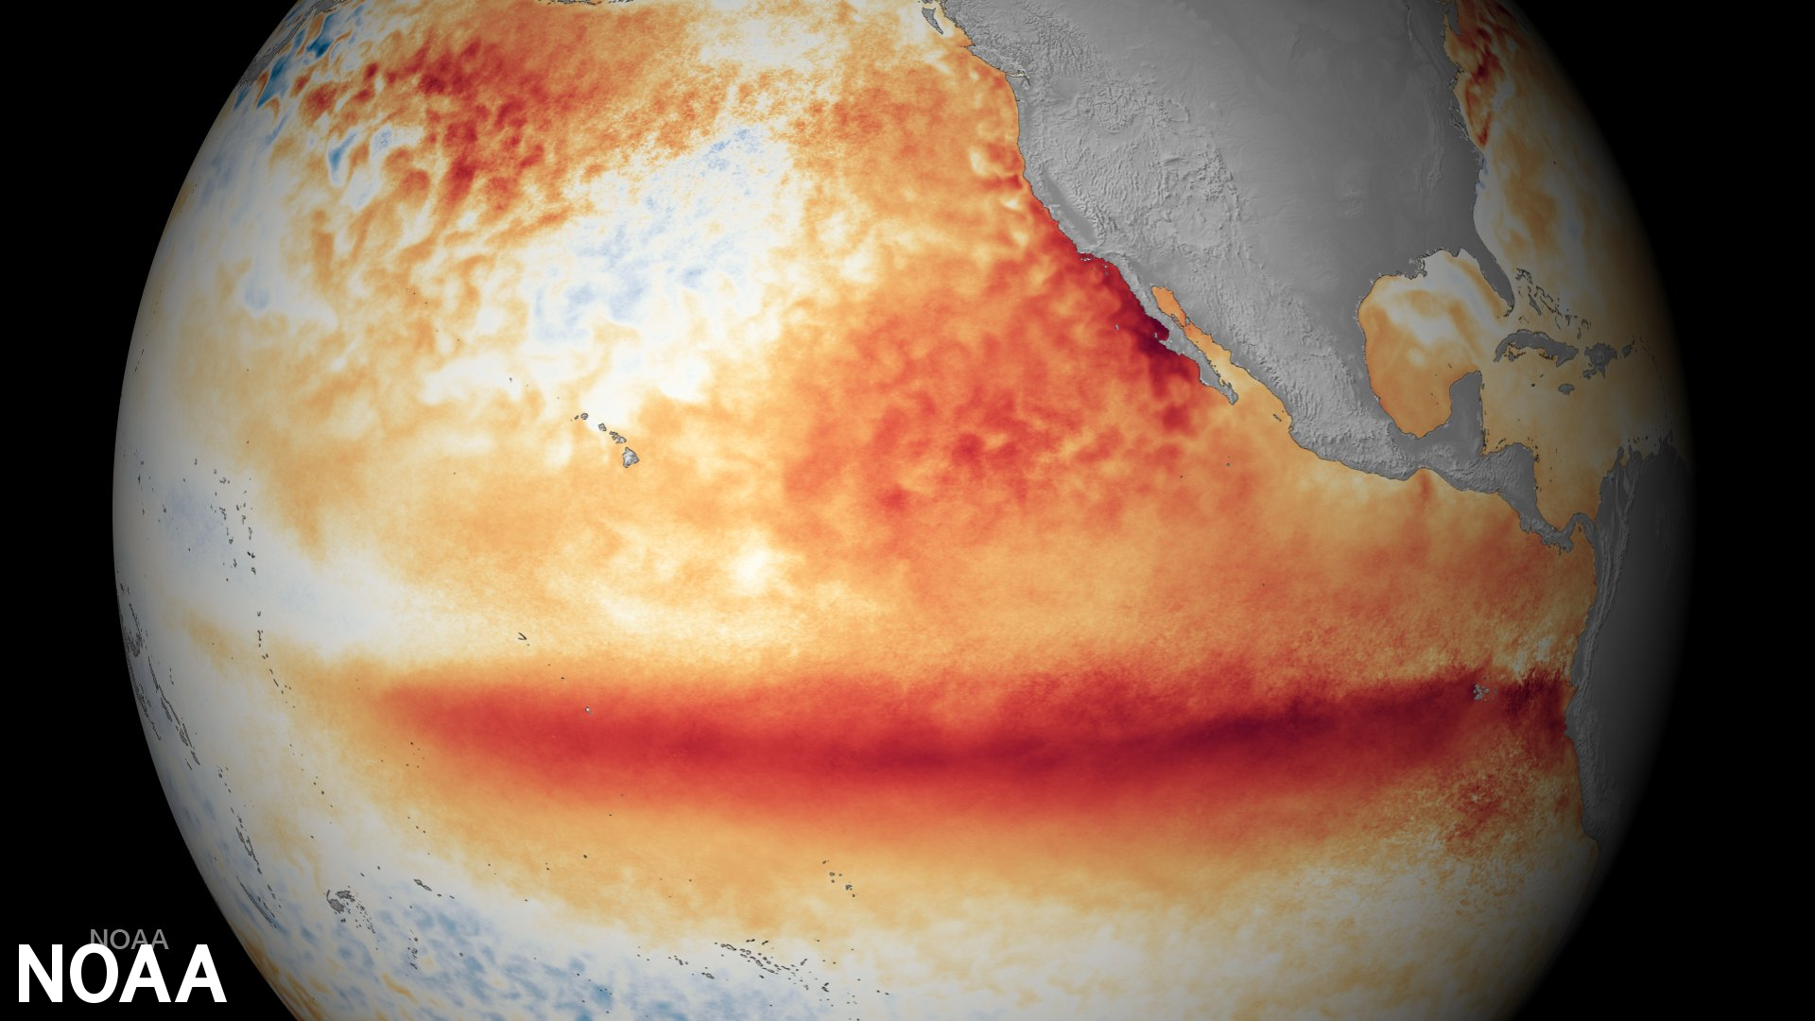
Recap of work so far
The 2023 El Niño
What a model “is”
Earth.nullschool.net products
https://www.noaa.gov/education/resource-collections/weather-atmosphere/el-nino

Slide 2
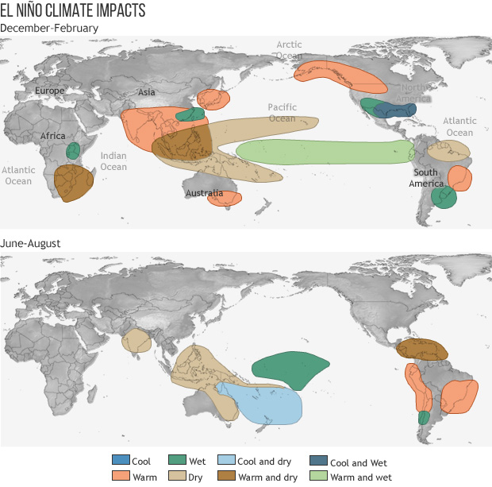
Recap of work so far
The 2023 El Niño
What a model “is”
Earth.nullschool.net products
https://www.pmel.noaa.gov/elnino/impacts-of-el-nino

Slide 3
Recap: What a model “is” (paraphrasing Prof. Shell)
The 2023 El Niño
What a model “is”
Earth.nullschool.net products
Set of mathematical equations, computer code, that simulates the climate in some way
Takes inputs*, produces outputs
Often we want to integrate forward in time from some initial condition (we’ll use Euler’s method)
Experiment = one or more individual simulations designed to answer some question (like: What changes if we double the CO₂?)
*Especially, assumptions about how much CO₂ humans will release over some time period (typically up till 2100, but why stop there?).

Slide 4
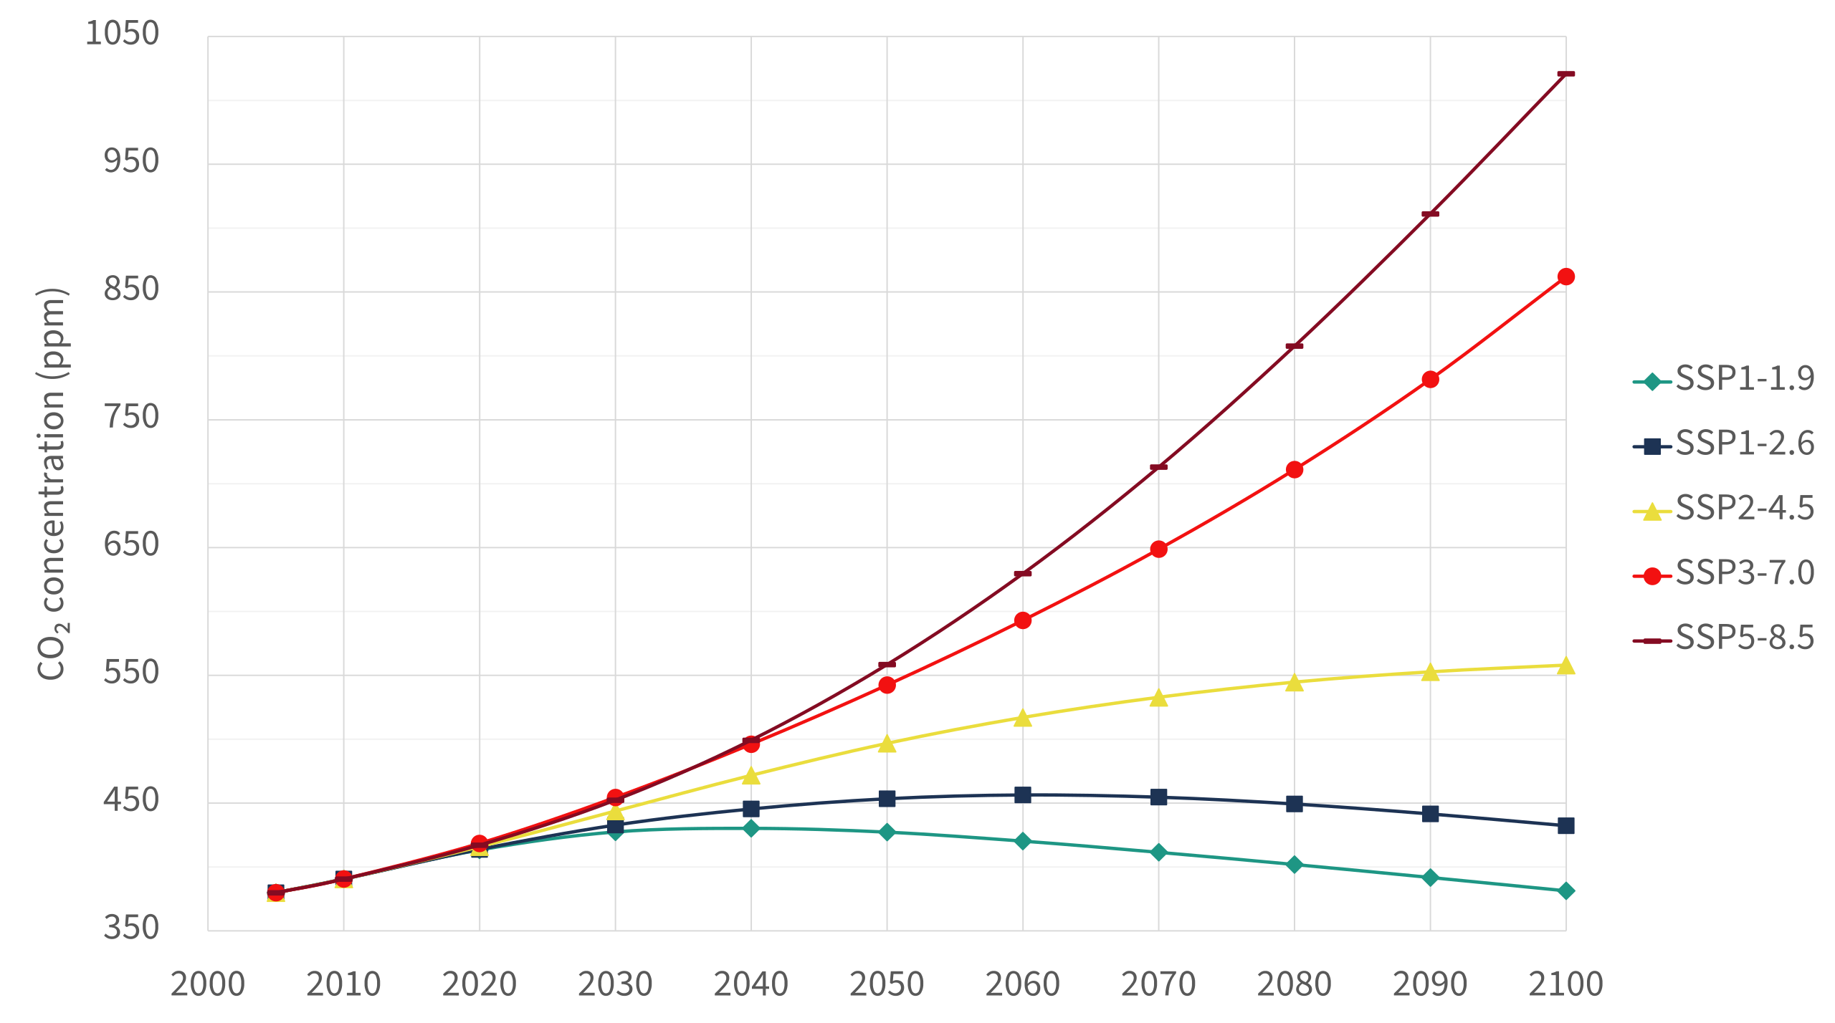
Emission scenarios and the climate sensitivity
RCP = Rep. Conc. Pathways (5th IPCC report, 2013)
SSP = New future scenarios (6th IPCC report, 2021)
https://en.wikipedia.org/wiki/Shared_Socioeconomic_Pathways

Slide 5
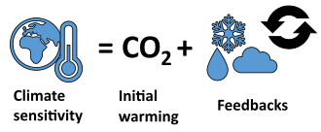
Emission scenarios and the climate sensitivity
RCP = Rep. Conc. Pathways (5th IPCC report, 2013)
SSP = New future scenarios (6th IPCC report, 2021)
https://en.wikipedia.org/wiki/Shared_Socioeconomic_Pathways

Slide 6
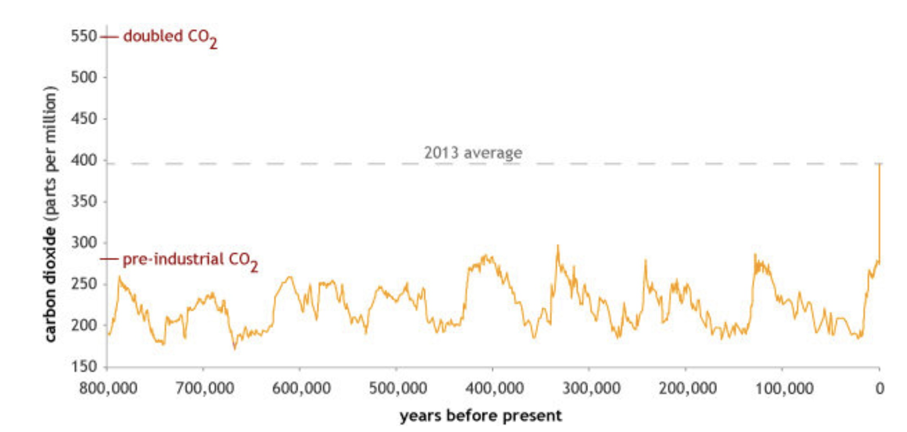
Climate Temperature Sensitivity is one way to quantify this
Doubling of CO₂ means going from 290 ppm pre-industrial, to 550 ppm.
Climate temperature sensitivity tries to quantify how many degrees warming will the world experience for that doubling.
https://www.climate.gov/news-features/climate-qa/how-much-will-earth-warm-if-carbon-dioxide-doubles-pre-industrial-levels

Slide 7
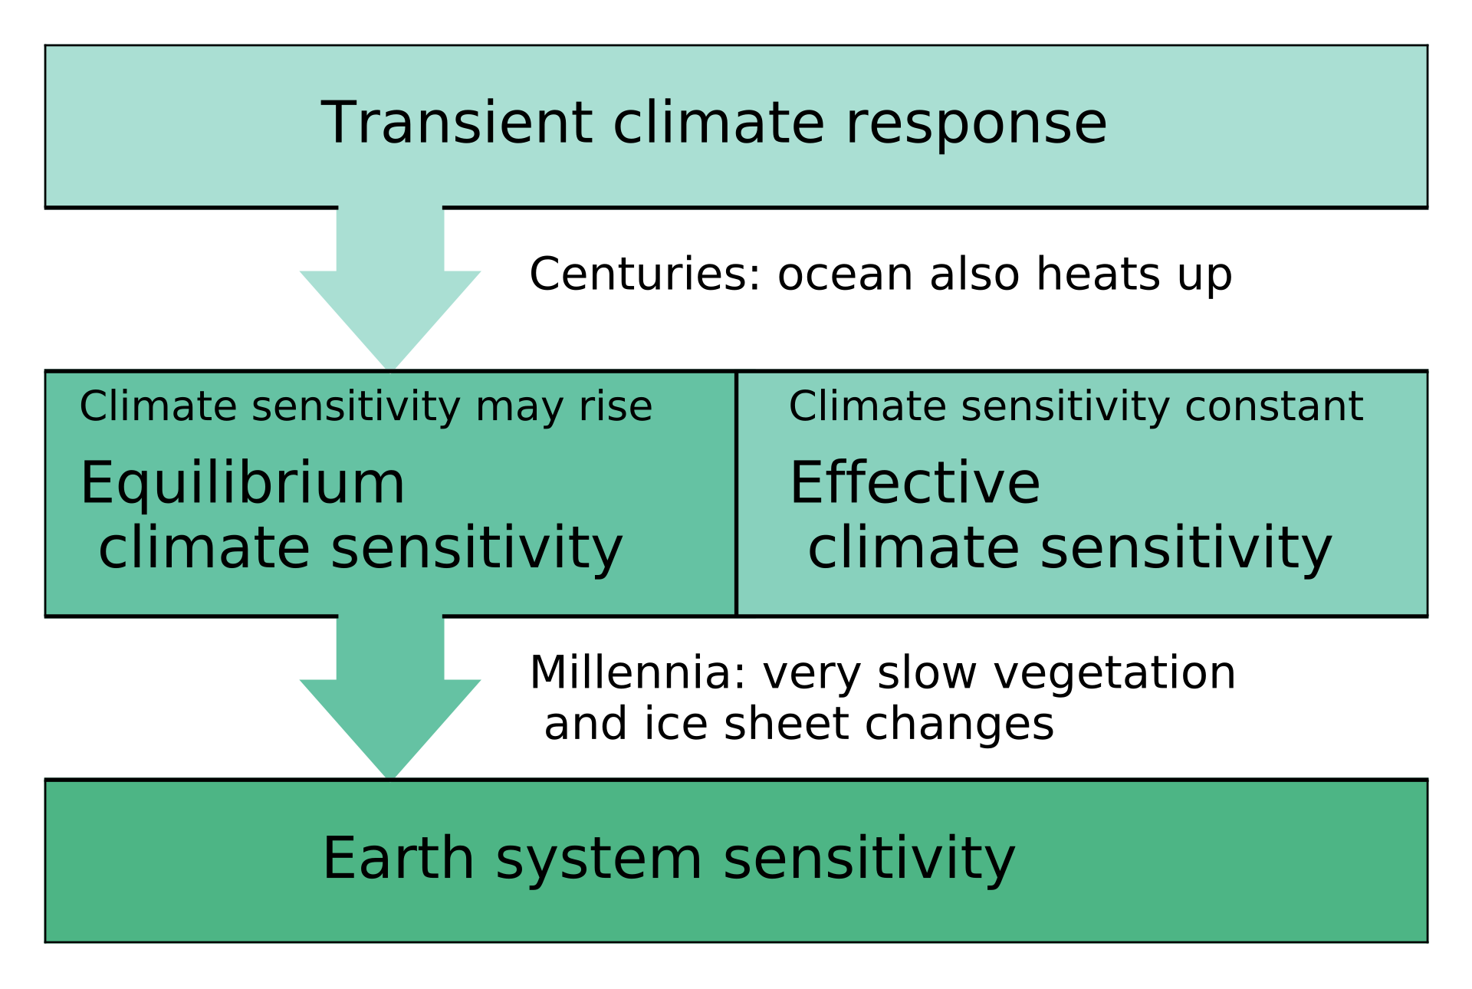
Climate Temperature Sensitivity is one way to quantify this
Doubling of CO₂ means going from 290 ppm pre-industrial, to 550 ppm.
Climate temperature sensitivity tries to quantify how many degrees warming will the world experience for that doubling.
https://www.climate.gov/news-features/climate-qa/how-much-will-earth-warm-if-carbon-dioxide-doubles-pre-industrial-levels

Slide 8
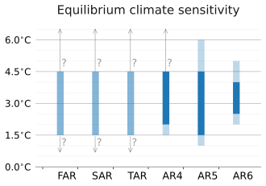
Climate Temperature Sensitivity is one way to quantify this
Doubling of CO₂ means going from 290 ppm pre-industrial, to 550 ppm.
Climate temperature sensitivity tries to quantify how many degrees warming will the world experience for that doubling.
https://www.climate.gov/news-features/climate-qa/how-much-will-earth-warm-if-carbon-dioxide-doubles-pre-industrial-levels
IPCC’s estimate back in 1990
IPCC’s estimate in 2021

Slide 9
Emission scenarios and the climate sensitivity
RCP = Rep. Conc. Pathways (5th IPCC report, 2013)
SSP = New future scenarios (6th IPCC report, 2021)
Doubling
https://en.wikipedia.org/wiki/Shared_Socioeconomic_Pathways

Slide 10
Recap: Earth.nullschool.net products
Fires
Jet Stream
Have to move up in the atmosphere to see this
The 2023 El Niño
What a model “is”
Earth.nullschool.net products
Surface air pollutant concentrations
This is CO, but there are also air-borne particulates, like sulfate (”SO4ex)
CO₂ concentrations
A key number is 418 ppm, the global average concentration in 2021

Slide 11
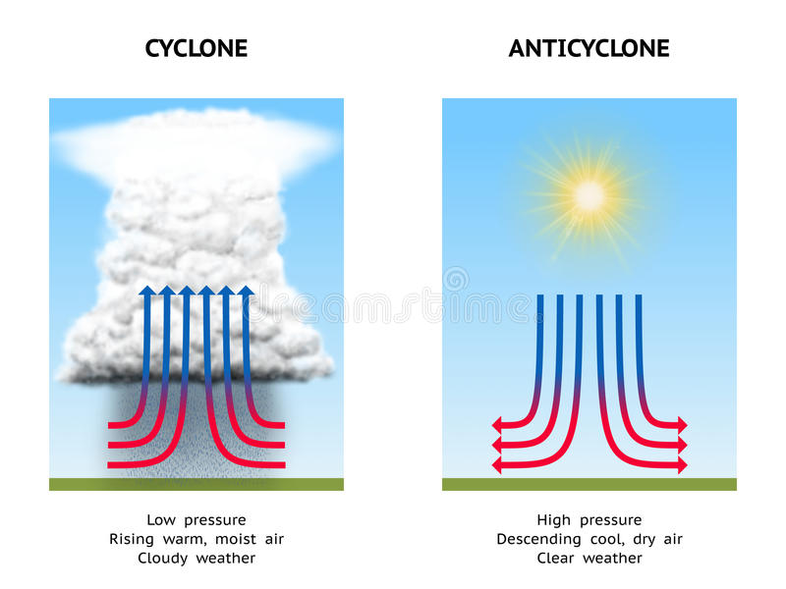
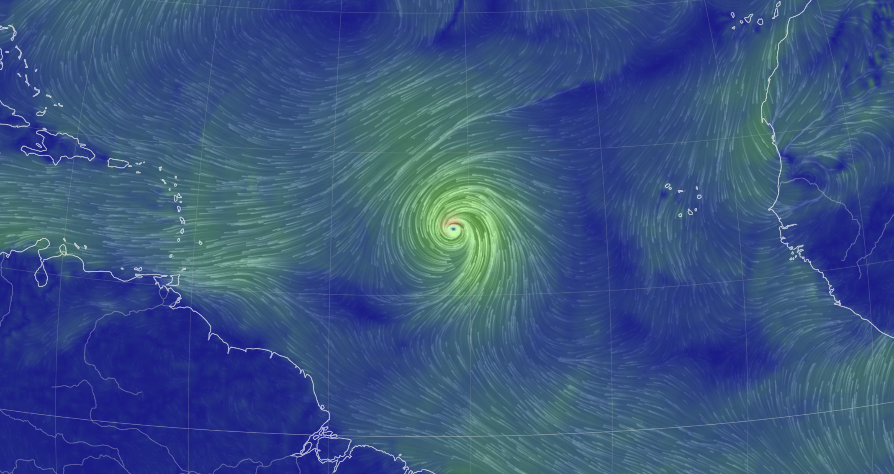
Cyclonic systems
Low-pressure system – stormy, cloudy, and rainy
Northern hemisphere, winds circling to the left
Southern hemisphere, winds circling to the right
https://thumbs.dreamstime.com/b/cyclone-anticyclone-diagram-illustrating-high-pressure-low-pressure-57971714.jpg

Slide 12
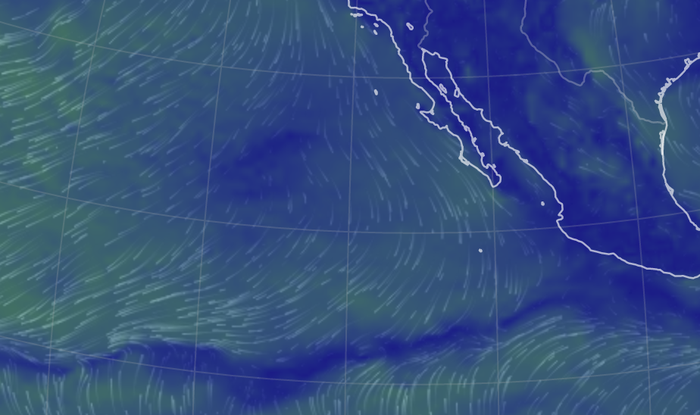
Anticyclonic systems
High-pressure system – Clear skies, dry
Northern hemisphere, winds circling to the right
Southern hemisphere, winds circling to the left
https://thumbs.dreamstime.com/b/cyclone-anticyclone-diagram-illustrating-high-pressure-low-pressure-57971714.jpg

Slide 13
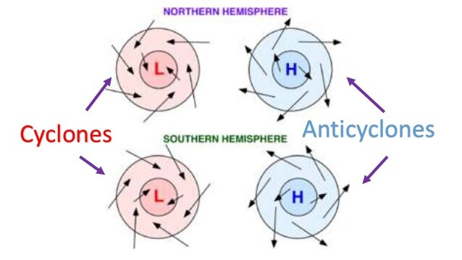
Summary of cyclonic & anticyclonic wind directions
https://revision.co.zw/cyclones/

Slide 14
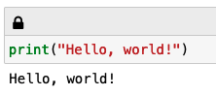
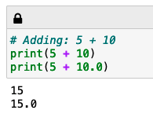
1st CGI of the week: Printing things & using Python as a calculator
Just printing some text
Printing the result of a calculation

Slide 15
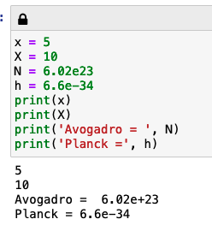
1st CGI of the week: Storing data as named variables
Upper/lower case matters!
Entering numbers in “E-format”
We can print multiple things together

Slide 16
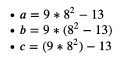
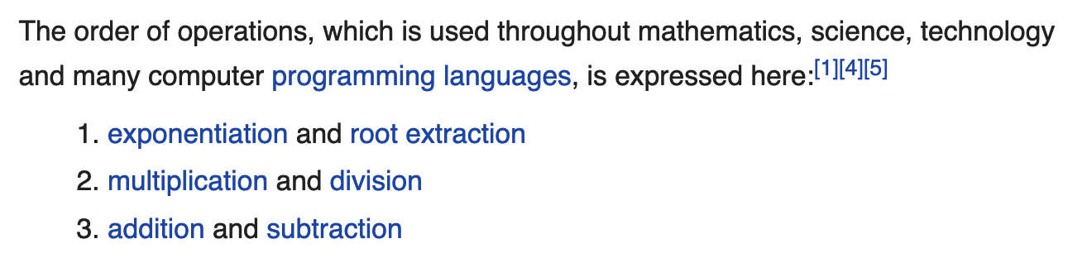
1st CGI of the week: Order of operations
Which one of these is different from the others?
https://en.wikipedia.org/wiki/Order_of_operations says …

Slide 17
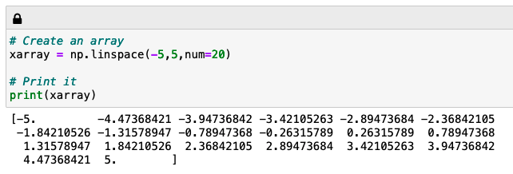
1st CGI of the week: Scalars vs arrays, and making arrays from other arrays
A scalar is just a single number, an array is a bunch of scalars
Numpy’s linspace function makes array-making easy
20 numbers in “xarray”

Slide 18
1st CGI of the week: Scalars vs arrays, and making arrays from other arrays
A variable calculated using an array is usually another array of the same length
20 numbers in “xarray”
20 numbers in “xsquared” and “rootx” too

Slide 19
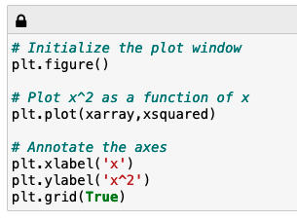
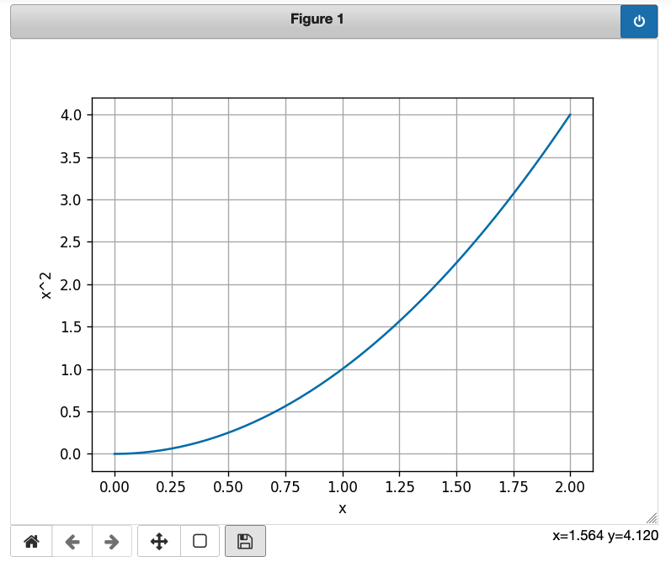
1st CGI of the week: Graphing
Use these to pan, zoom, and save!

Slide 20
2nd CGI of the week: Exploring a correlation
Hypothesis: Lower pressure at the center of a cyclonic synoptic system => faster winds around the center.
Earth.nullschool.net + Python will let you explore whether that’s true!
https://revision.co.zw/cyclones/

Slide 21
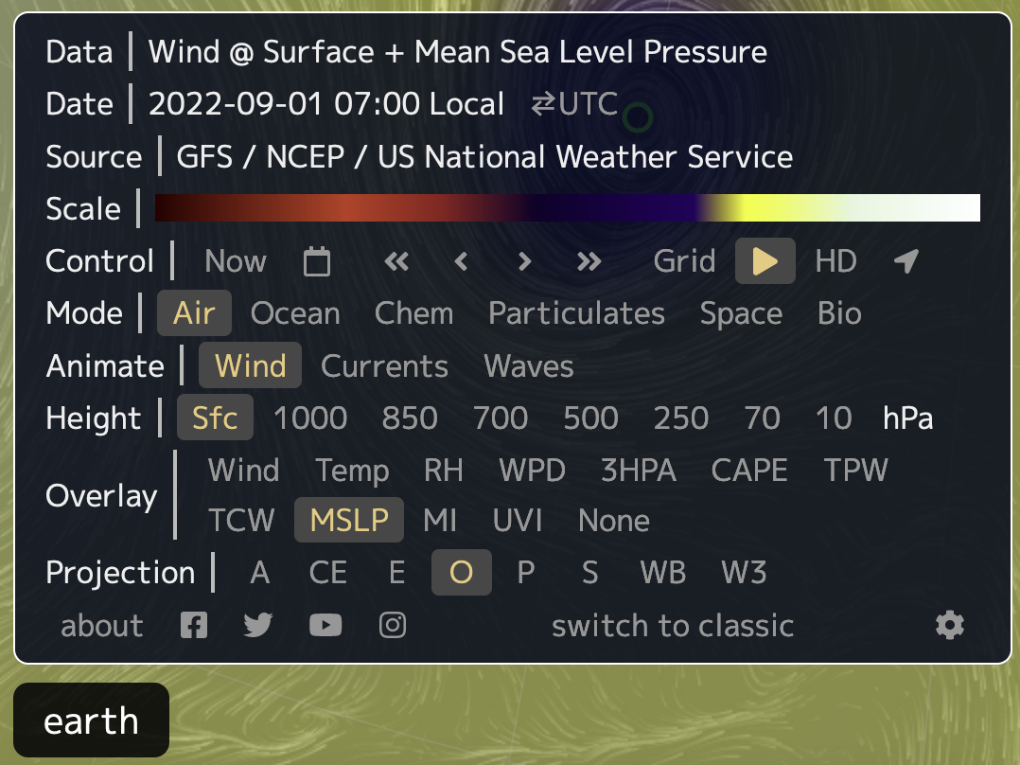
2nd CGI of the week: Exploring a correlation

Slide 22
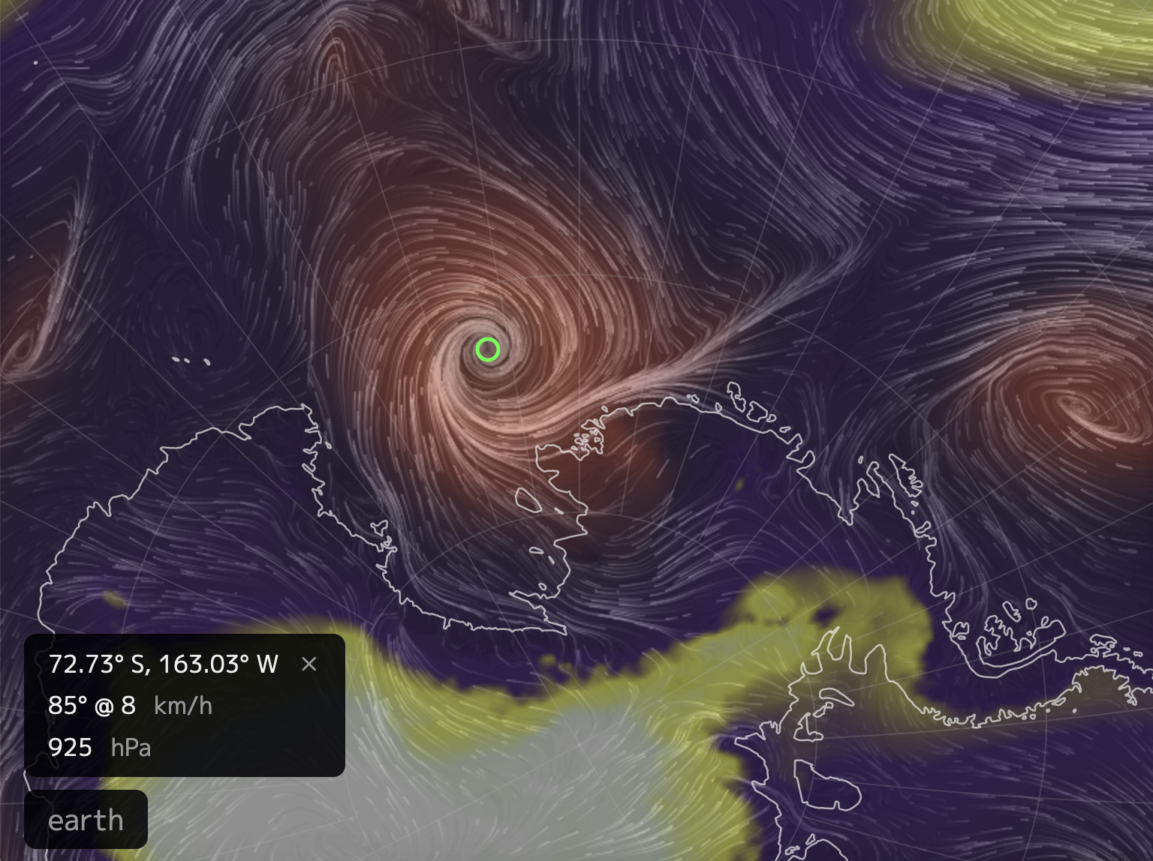
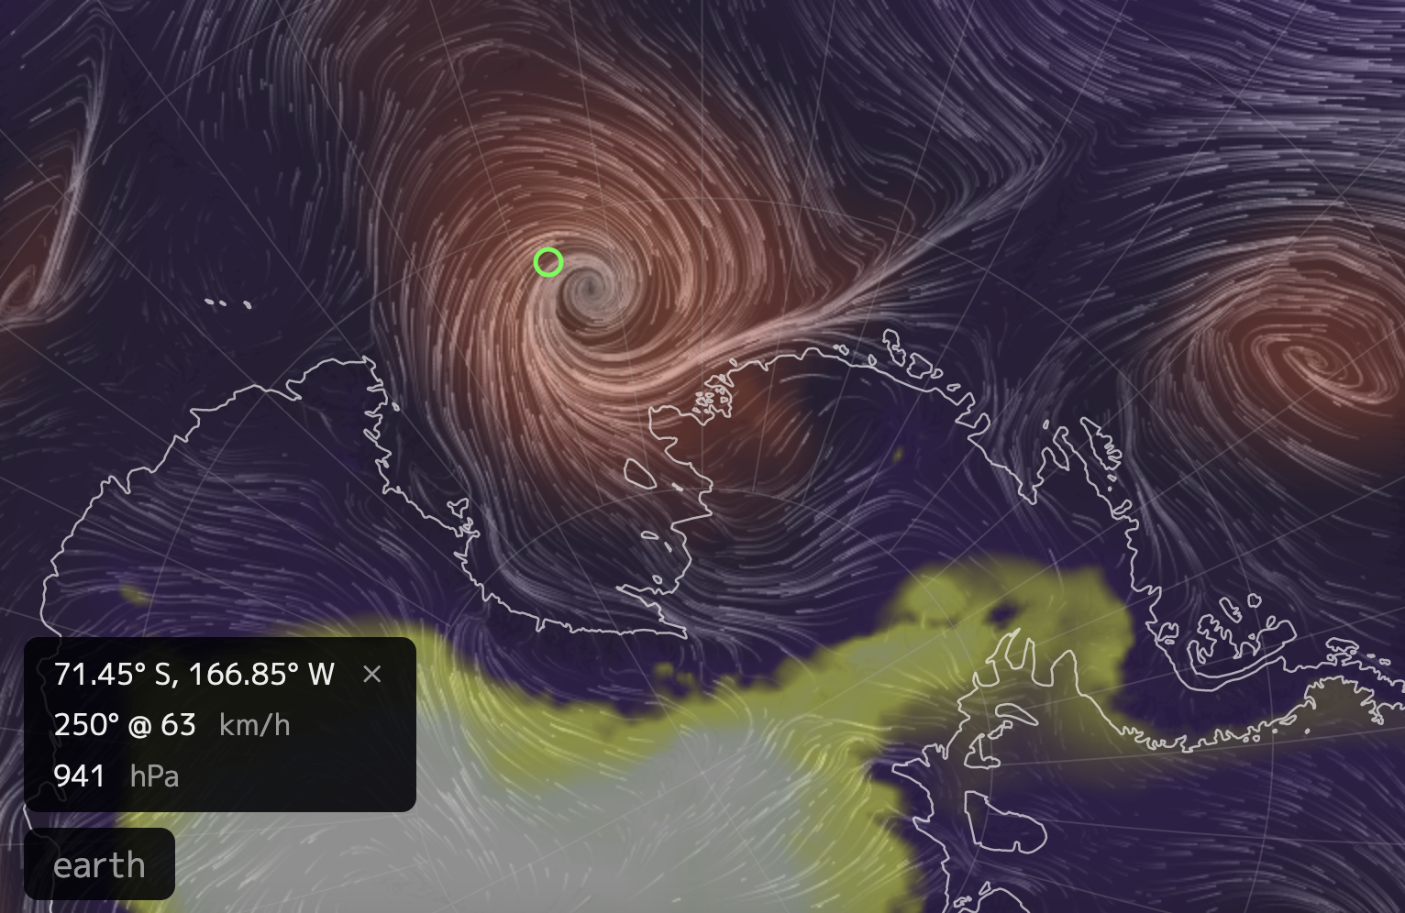
2nd CGI of the week: Exploring a correlation
Pressure at the center of the cell
Maximum wind speed somewhere around the cell

Slide 23
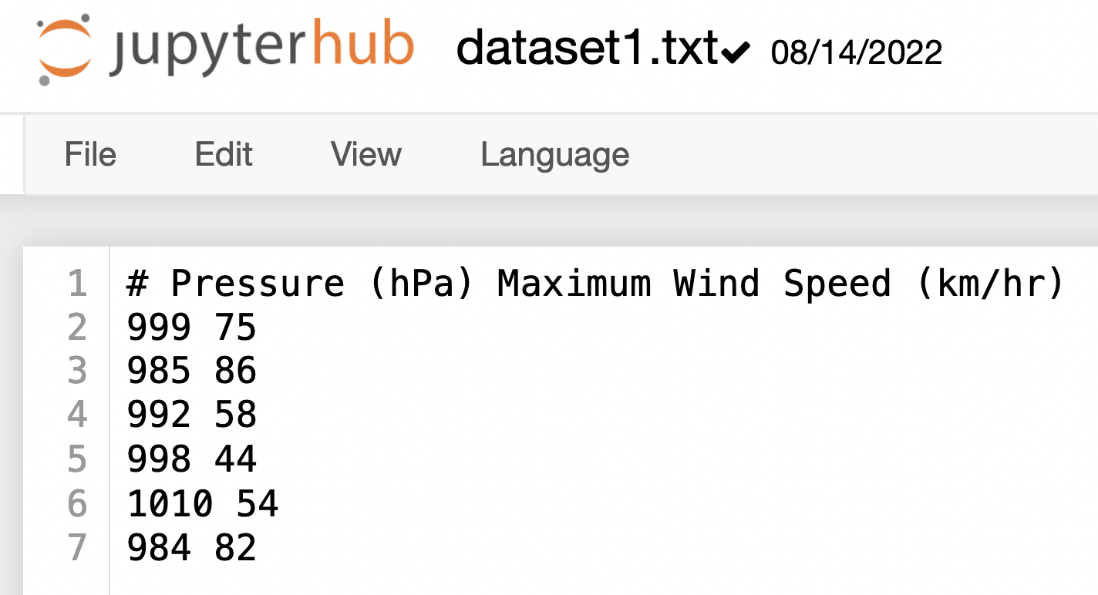
2nd CGI of the week: Exploring a correlation
Here are some sample data in the file dataset1.txt

Slide 24
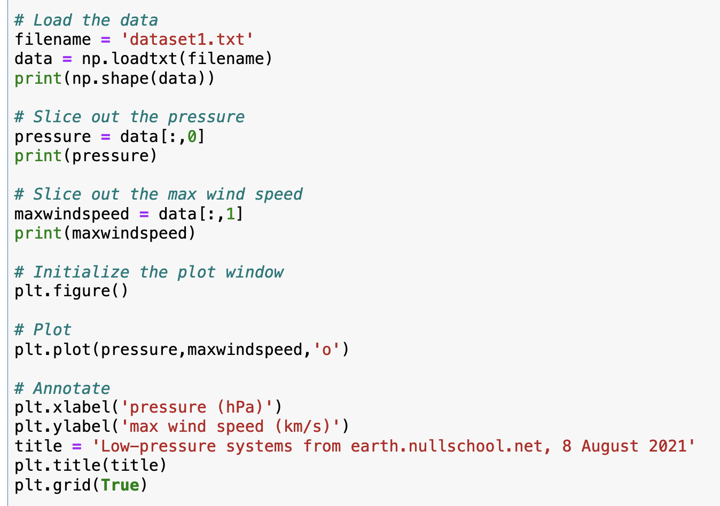
2nd CGI of the week: Exploring a correlation
Here’s how loading works

Slide 25
2nd CGI of the week: Exploring a correlation
And here’s how slicing works

Slide 26
2nd CGI of the week: Exploring a correlation
And here’s how slicing works

Slide 27
2nd CGI of the week: Exploring a correlation
And here’s how slicing works

Slide 28
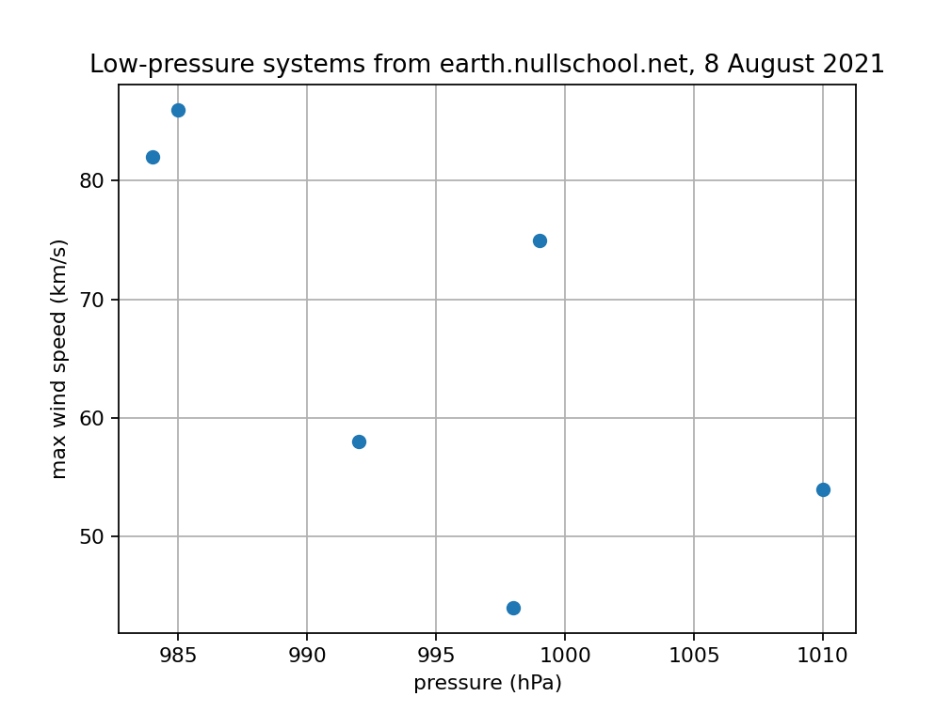
2nd CGI of the week: Exploring a correlation
And here’s what the data look like as a scatter plot

Slide 29
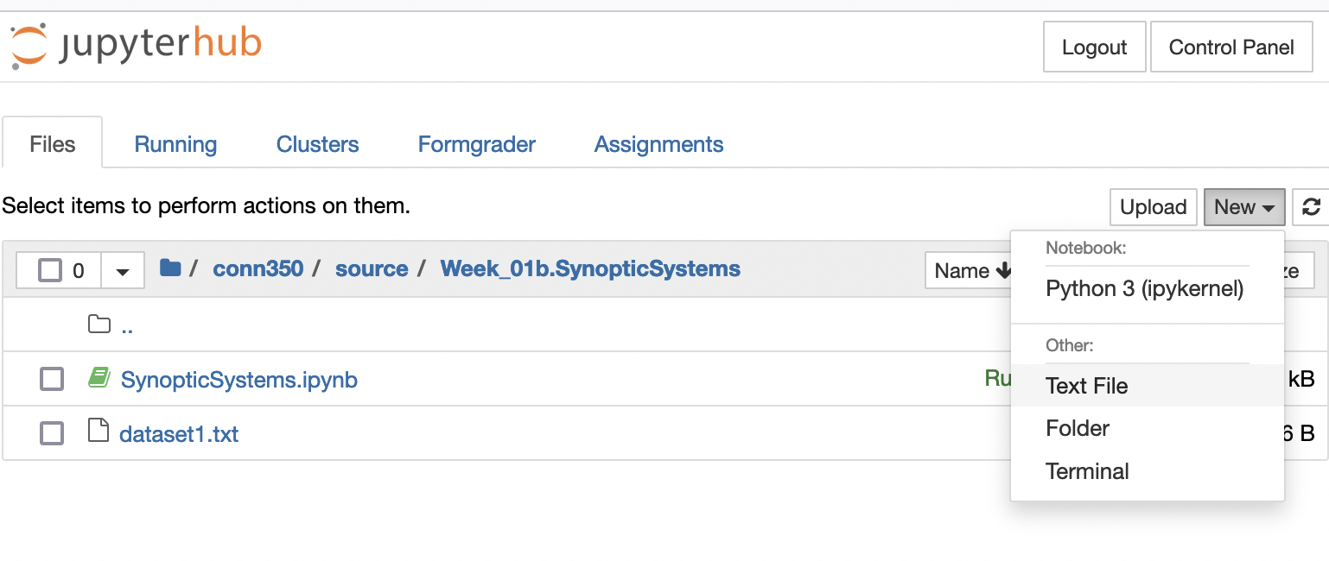
2nd CGI of the week: Exploring a correlation
You’ll put your data in dataset2.txt

